Slide 1


Module 3: HoNOS uses and becoming a trainer

Slide 2
Recap module 2
Use of glossary
Emphasis on clinical significance
Practice in rating

Slide 3
Individual clinician uses
recording a comprehensive assessment
fostering a therapeutic relationship
developing a clear plan of care
allocating referrals
MDT uses

Slide 4
How can HoNOS help the tāngata whai ora - clinician conversation? - Improvement
Change in tangata whai ora over time
4
3
Time 1
Time 2
Scale
2
1
0
AGR
SH
AOD
COG
PHY
Del/HAL
DEP
OTH
REL
ADL
LIV
OCC
Measure
Notes:
Take some time to explain that not everyone responds to graphs but that some s could certainly benefit (provided they are given the choice)

Slide 5
How can HoNOS help the tāngata whai ora-clinician conversation? - Deterioration
Change in tangata whai ora over time
4
3
Time 1
Time 2
Scale
2
1
0
AGR
SH
AOD
COG
PHY
Del/HAL
DEP
OTH
REL
ADL
LIV
OCC
Measure

Slide 6
Break out groups
Discuss how you would feedback this kind of individual information to tangata whai ora?

Slide 7
Brief narrative
Jude is a 40 year women with a 10 year history of depression
received support from the local community mental health team over a six-month period
lives alone, has no children and is unemployed
Jude’s involvement in treatment decisions is important to her

Slide 8
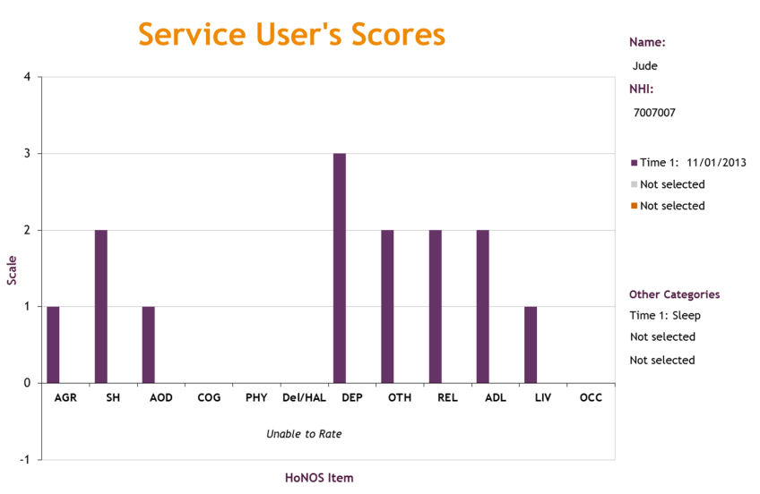

Slide 9
Collabortive planning
Jude: HoNOS items
Item and rating | Mark (nurse) | Jude
(7) Depression 3 | ensure Jude has Venlafaxine and taking as prescribed ensure Jude has a chance to talk through the issues which are affecting her | take Venlafaxine use distraction techniques use sleeping pill if necessary call CATT if unsafe (to organise respite)
(2) Self harm 2 | monitor Jude’s mental state and provide risk assessment with regular home visits | use distraction techniques (eg crochet to keep my hands busy or tearing up old phonebook)
(8H) Sleep 2 | ensure Jude has a supply of Zopiclone and taking as prescribed | use sleeping pill if necessary stay awake and go for a walk in the day set up budgeting appointment with Citizens Advice Bureau

Slide 10
Break out groups
Discuss how you would use HoNOS to plan care?

Slide 11
A quick strategy for using HoNOS in the MDT
https://www.tepou.co.nz/uploads/files/resource-assets/Using-HoNOS-to-help-plan-for-care-and-recovery.pdf
Notes:
Refer to the Quick strategy handout page in your folders

Slide 12
Make more efficient and effective discussions
complete prior to review
one page long - quick
helps clarify thinking about a tanga whai ora
focuses on identifying solutions
https://www.tepou.co.nz/uploads/files/resource-assets/Multi-disciplinary-team-review-form.pdf
Notes:
Please refer to the MDT Review form in your folders

Slide 13
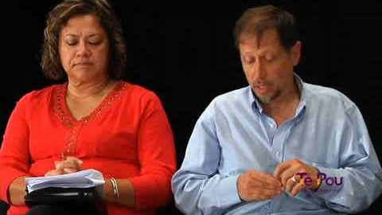

Slide 14
Break out groups
Discuss using HoNOS in the MDT

Slide 15
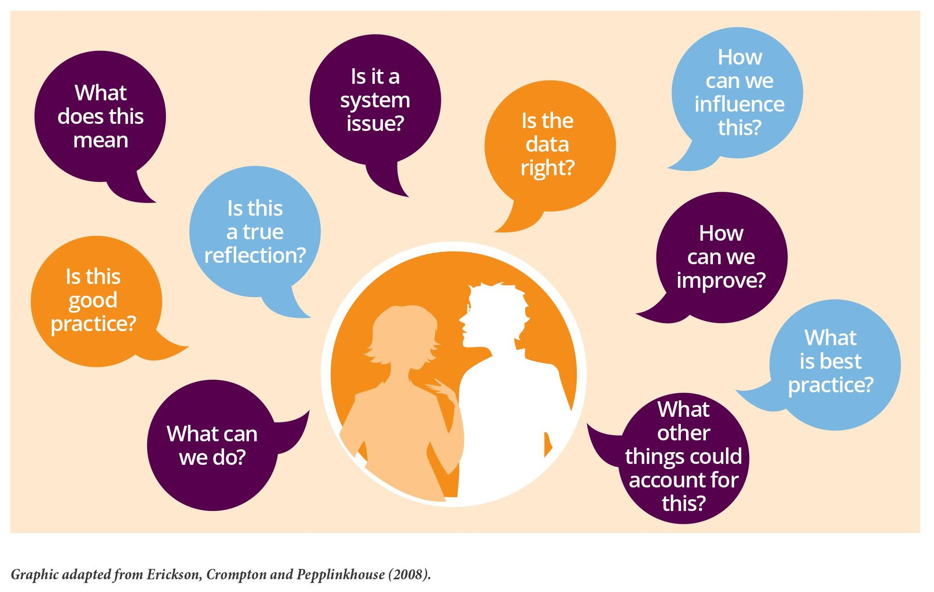
Questioning the data
Notes:
By questioning the data then they will start see the meaning and also give them incentive to collect the data correctly.
Te Pou resource: Making a difference with data 3. Collecting and using data well.

Slide 16
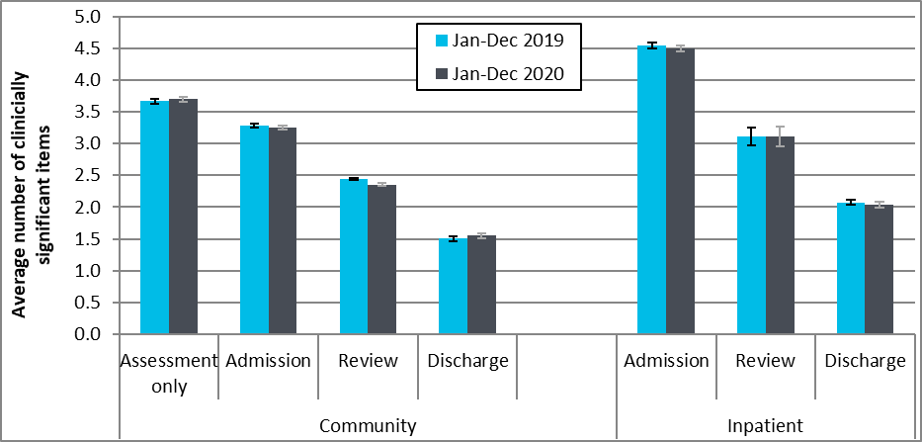
Average number of clinically significant HoNOS items by collection type and setting: New Zealand, Jan to Dec 2019 and Jan to Dec 2020
Note: Average number clinically significant items = the average number of items in the clinical range 12 items (2, 3 or 4) per collection. Community discharge does not include discharge to an inpatient unit. Source: Ministry of Health, PRIMHD extract 28 March 2021, analysed and formatted by Te Pou.

Slide 17
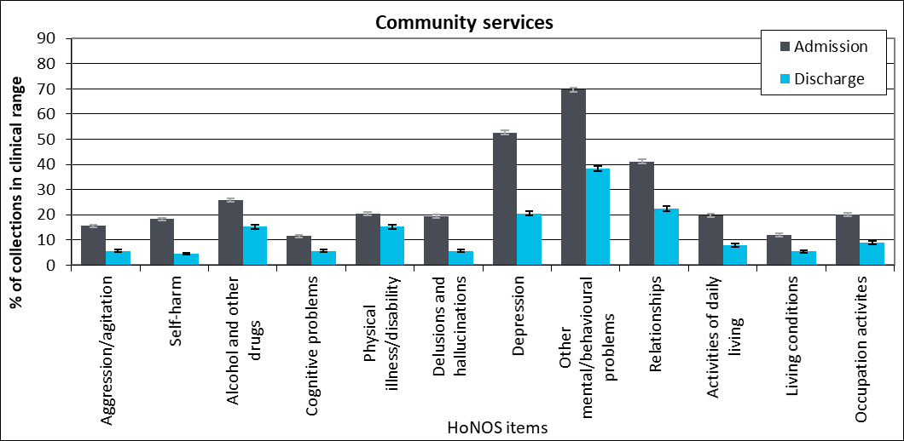
Percentage of collections in clinical range on each HoNOS items by collection type, community: all DHBs, Jan to Dec 2020
Note: Percentage of service users in the clinical range (2, 3 or 4) for each HoNOS. Community discharge does not include discharge to an inpatient unit. Source: Ministry of Health, PRIMHD extract 28 March 2021, analysed and formatted by Te Pou.

Slide 18
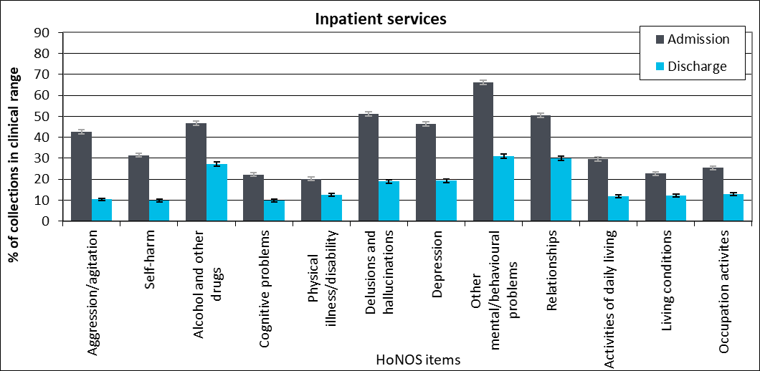
Percentage of collections in clinical range on each HoNOS items by collection type, inpatient: all DHBs, Jan to Dec 2020
Note: Percentage of service users in the clinical range (2, 3 or 4) for each HoNOS. Source: Ministry of Health, PRIMHD extract 28 March 2021, analysed and formatted by Te Pou.

Slide 19
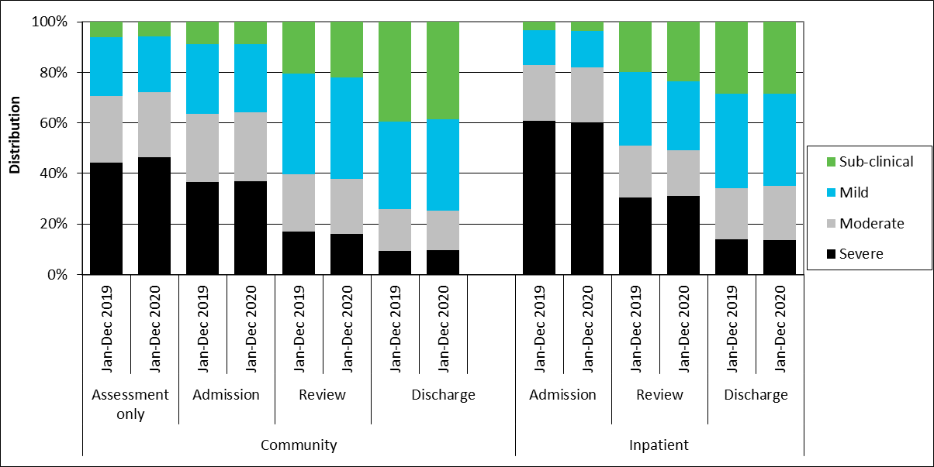
Index of Severity for HoNOS by collection type and setting, all DHBs, Jan to Dec 2019 and Jan to Dec 2020
Note: Index of Severity: Sub clinical = all items <2, mild = at least one item >1 and all items <3, moderate = at least one item >=3, severe = at least 2 items >=3 using first 10. Community discharge does not include discharge to an inpatient unit. Source: Ministry of Health, PRIMHD extract 28 March 2021, analysed and formatted by Te Pou.

Slide 20
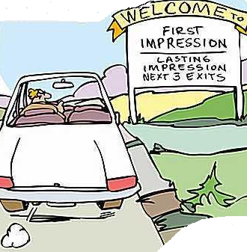
As a trainer
You have 1 minute to win people over
Seven observable behaviours
facial expressions
eye contact
voice & vocal tone, words and language
gestures
movement
Stance & body language
dress

Slide 21
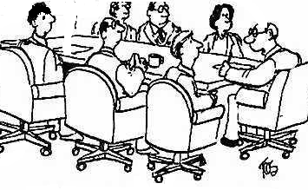
Elements of being a trainer
voice modulation
visual support
eye contact
gestures
fun
Jones, you’re a good communicator, look down the table and make eye contact for me
Notes:
Voice mod –draw continuum on board
Visual support
Flip charts
Whiteboards
PowerPoint
Video / DVD
Items
Eye contact. Pick up…aim…deliver 4 secs eye contact before moving on ,try to look at every person or at every part of a large group
Gestures
Past/ present future
Ideas n space
Yardstick
Hierarchy
Descriptive
Graph
Motivation
Counting

Slide 22
Break out Groups
Discuss how you will implement training in your service?
10 mins to discuss -

Slide 23



Guides for New Zealand Clinicians
https://www.tepou.co.nz/resources/search/tag/outcome-measures

Slide 24



Involving tāngata whai ora

Slide 25
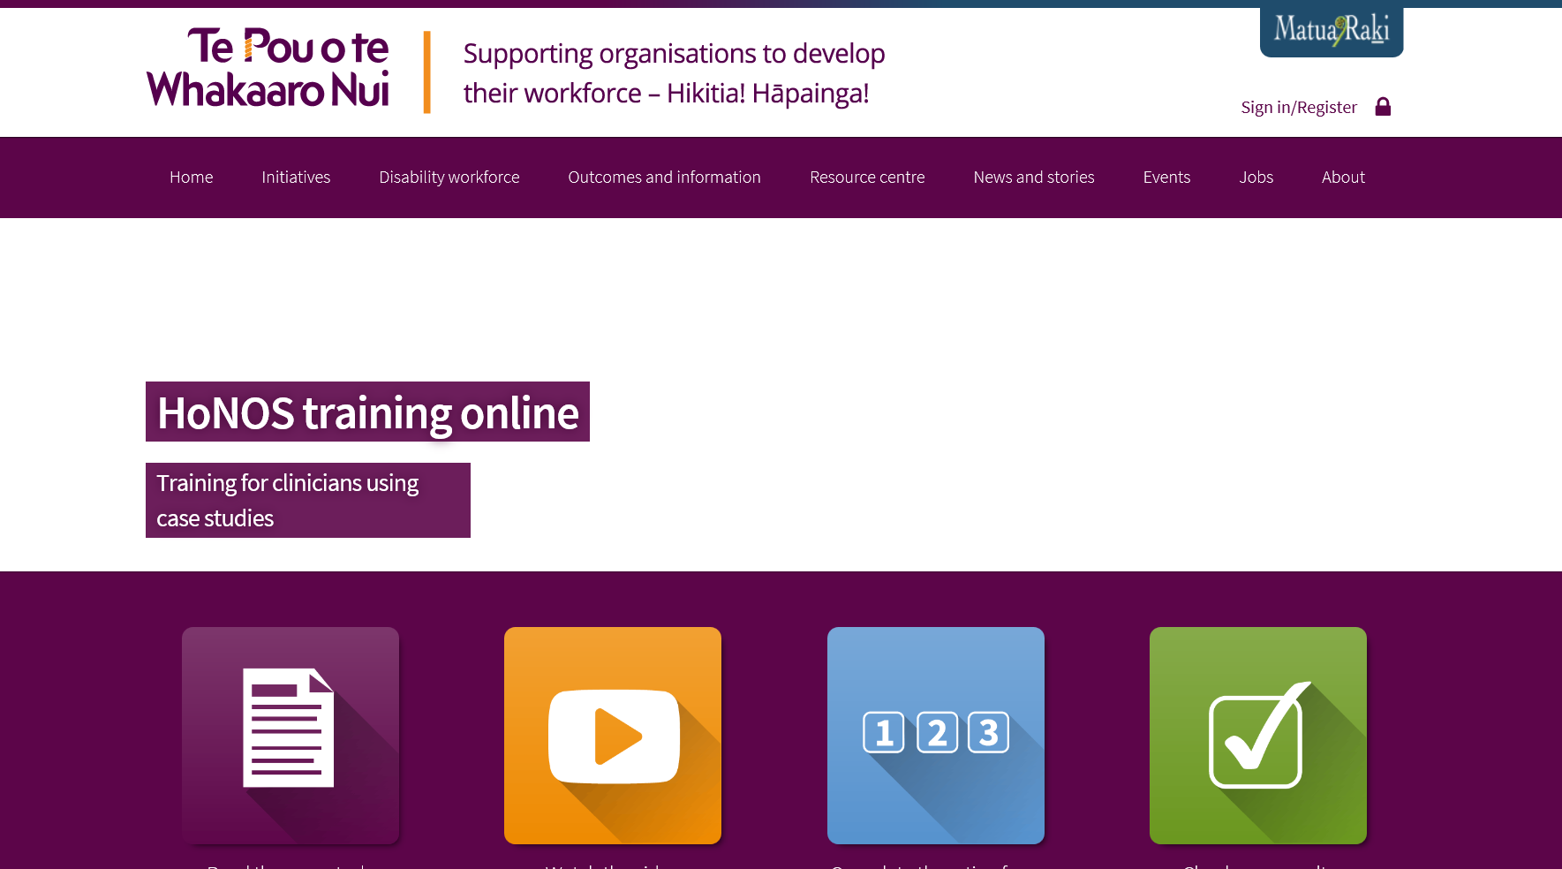
HoNOS online training
http://www.tepou.co.nz/outcomes-and-information/honos-training-online/33

Slide 26
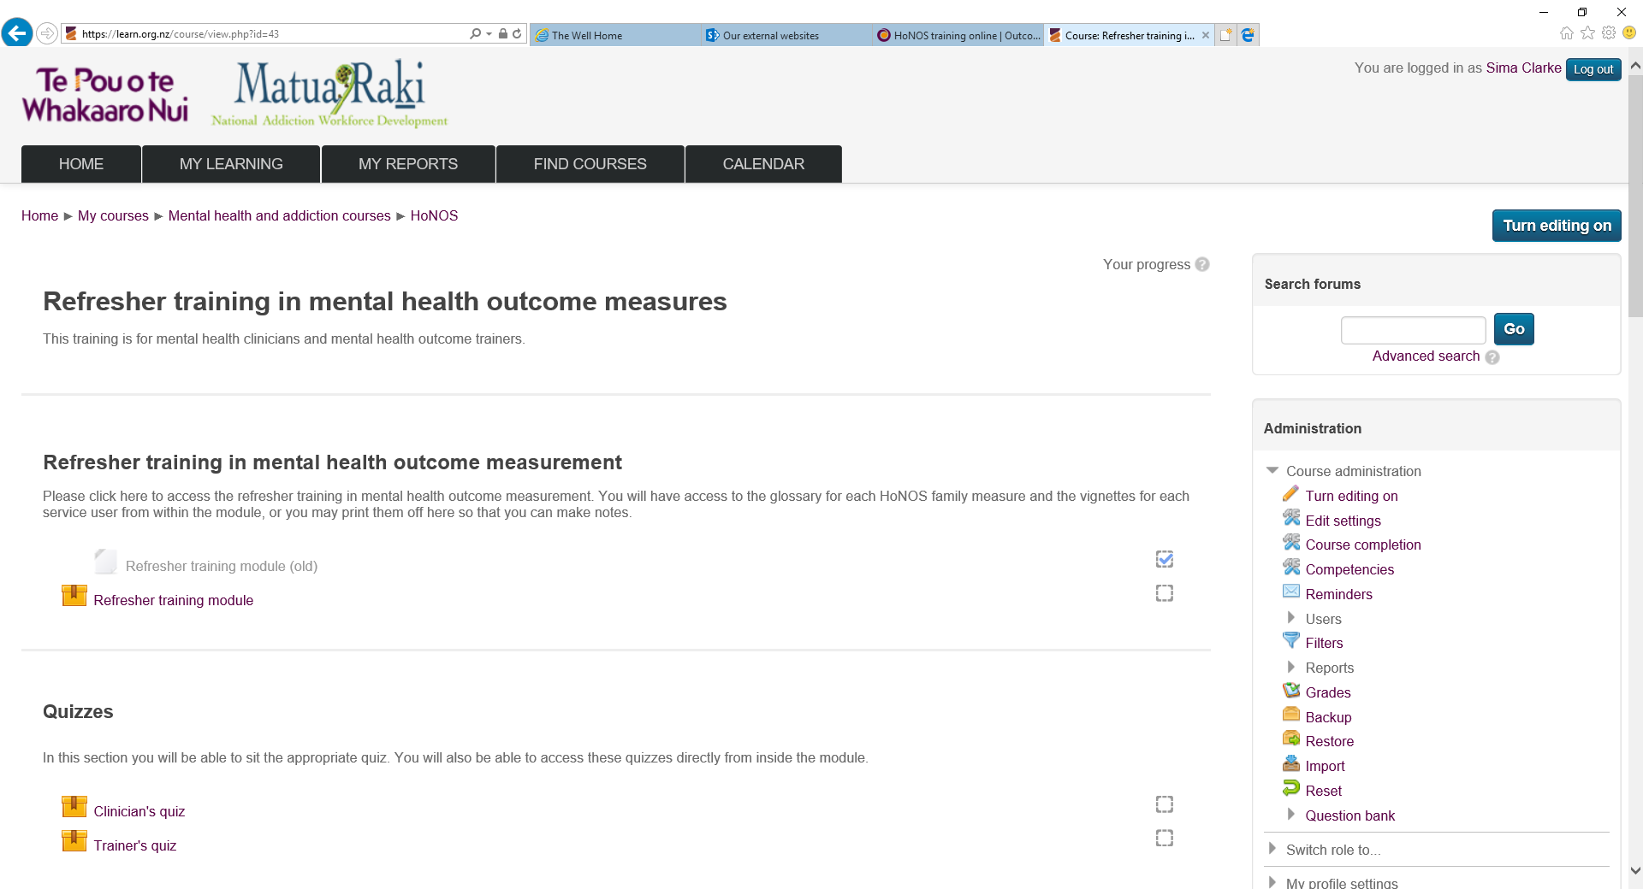
HoNOS e-learning refresher
www.tepou.co.nz/outcomes-and-information/honos-training-online/33

Slide 27
HoNOS family introductory training
New e-learning resource available as an introductory resource for trainers to use with clinicians

Slide 28
Secure resources for trainers
Videos and other resources not available on website.
How?
Register on the Te Pou website
Click on ‘Secure resources’ tab
Click ‘Request access’
Access is moderated by team. A confirmation email will be sent

Slide 29
Poll
How confident are you training others in a HoNOS family measure?

Slide 30


