Slide 1


Train the trainer
HoNOS family of measures

Slide 2
Introductions
Introductions –people & resources

Slide 3
Outcomes…
it’s all about showing how
recovery happens!
Notes:
Welcome
Thanks for coming to this training
This training is important – it’s all about showing how recovery happens
Housekeeping, toilet, cellphones, health and safety, e.g. fire exits, gathering point

Slide 4
Learning objectives
understand foundational training key messages in outcome measurement
understand collection of HoNOS family outcome scores
understand how outcome measurement is useful
resources and tools available to support you as outcome trainers
Notes:
Come back to these objectives at the end of each day – ask participants: Are we achieving these? If the answer is NO, ask why? and address the reason(s).

Slide 5
Poll
How confident are you in training others in a HoNOS family measure?

Slide 6
Overview of modular training
Module 1: Background to HoNOS family and collecting reliably
Module 2: Focus on each of the 5 HoNOS family measures mandated in NZ (each of the 5 is a stand alone session)
Module 3: Uses of HoNOS family of measures & becoming a trainer

Slide 7
Recap pre reading
Slides sent out in advance

Slide 8
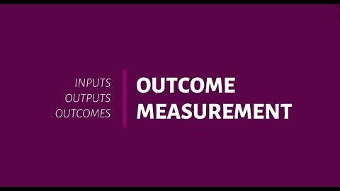

Slide 9
Break out groups
Discuss the video.
Are you clear about the differences between inputs, outputs and outcomes? 10 mins to briefly introduce yourself & discuss question with no expectation of sharing with larger group.

Slide 10
What are MH outcomes?
Discuss as a large group
MH-SMART definition:
‘Changes in the mental health of individuals or populations using mental health services.’
Notes:
This could be viewed as the change in a persons health, wellbeing or circumstance.
However we cannot attribute this change entirely to using MH services (remember people get well with out MH service input).

Slide 11
Background to outcome measures
1990’s Development of HoNOS measures
2002 DHB crown funding agreements in NZ
2003 CAOS - classification and outcome study
2004 MHSMART (mental health standard measures of recovery initiative)
2005 National mental health information strategy
2008 PRIMHD programme for the integration of mental health data

Slide 12
Background cont.
2009 KPI key performance indicator development
2010 Standard outcome reports available to sector
2011/12 Ministry of Health policy direction on outcome measures and compliance
2016 Health strategy and outcome framework, commissioning framework
2019 He Ara Oranga report

Slide 13
Context for training
Support recovery by promoting and facilitating the development of an outcomes-focused culture in the mental health sector.
Ensure a sound understanding of the philosophical underpinnings of recovery.
Necessary structures and processes to support an outcomes-focused culture.
Responsiveness to Māori is critical.
Notes:
Key messages
This does not replace the recovery training but sits alongside it and supports recovery

Slide 14
Outcome training model
Minimum of 2 yearly after basic training
Refresher training for clinicians
Emphasis on inter-rater reliability and clinical pathways
Minimum of 1 day training
Basic outcome training at DHB level for clinicians
The extent of regional support will depend on DHB/MOH resourcing
Minimum of 2 yearly to keep certification
Refresher training
Link to information use training
HoNOS | HoNOS65+ | HoNOSCA | HoNOS_LD | HoNOS secure
1 day modular training
Prerequisite
2 Days
Foundational training (regional)
Certification based on Let’s get real
Content
key messages
outcomes & recovery
engagement
Feedback
inter-rater reliability
training skills
training resources.
Trainer pre-requisite
clinician familiar with
outcome measure
minimum of 1 year using
the measure.
7 Real Skills
working with service users
working with Māori
working with families
working with communities
challenging stigma/discrimination
law, policy and practice
professional and personal development.
Notes:
Make this handout available for clinicians you are training to help explain the outcome training model and guide

Slide 15
Break out Groups
Discuss: What I understand about the training model? Take 5 mins to discuss with no expectation of sharing with wider group

Slide 16
Research base to outcome tools
Wing et al, 1995
Mental health classification and service cost (MH CASC) project, 1996
NZ CAOS project, 2002
Pirkis et al, 2005
Te Pou technical review, 2012
International review 2020 underway
Notes:
The HoNOS suite of measures has a significant research underpinning which demonstrates the validity and inter-rater reliability of the measures.
The report “HoNOS: Report on research and development July 1993-December 1995” by JK Wing, RH Curtis and AS Beevor (1996) from the royal college of psychiatrists highlights much of that research.

Slide 17
Validity
The extent to which HoNOS measures what it is meant to measure.
The tool has good validity (Wing et al, 1996).
Notes:
The HoNOS tools have good psychometric properties and are, consequently, considered to be validated. Please see the Wing et al (1996) report for full details on the field trials and psychometrics.
Pirkis J et al (2005) in A review of the psychometric properties of the HoNOS family of measures study found that the HoNOS family of measures had reasonable properties based on test-retest studies

Slide 18
Inter-rater reliability
Generally good inter-rater reliability, provided raters:
use the reference guide and
practice scoring with some peer review.
Notes:
Inter-rater reliability is the extent to which two raters agree on the same ratings given the same circumstances.
The HoNOS measures score well on measures of inter-rater reliability (please see the Wing et al (1996) document which indicates they have good to very good inter-rater reliability).

Slide 19
Break out groups
Discuss: What is my understanding about reliability and validity in relation to outcome measurement. Take 10 mins with no expectation of feeding back.

Slide 20
Approach based on the HoNOS family
80 per cent HoNOS collection rate required. This is a Ministry requirement.
First three HoNOS tools are age based:
  adult & older adult – HoNOS and HoNOS65+
  Child and adolescent – HoNOSCA
  HoNOS LD/HoNOS secure focused on specific populations
Notes:
HoNOS family of measures – developed by Wing et al at the Royal college of psychiatrists

Slide 21
Data collection protocol
This covers:
when ratings are completed
who completes ratings
what information is collected

Slide 22
Collection points
seen once or twice only – no further follow up then assessment only
Discharge
Collection occasion
Admission
Collection occasion
Collection occasion date
Review
Collection occasion
Review
other
Service request or referral or intake
Accepted for treatment or care – start set of ratings completed
91 days
At least every 3 months
No further treatment or care planned for this MH setting
Less than 91 days
Maybe, further assessment or
information required
Notes:
Overview only. There is likely to be more specific local rules in place which site coordinators know in detail

Slide 23
When to collect
Episode start
1. admission for assessment only
2. admission new referral
3. admission from other treatment setting (transfer between community and inpatient)
4. admission other.
Admission HoNOS
Notes:
Key difference here is between referral for assessment only and new referral

Slide 24
When to collect
Episode start
Review
  1. Three month review
Admission HoNOS
3 month review HoNOS
Notes:
Try to get staff to align with current practice. Remember national MH standards say every person should be reviewed at least 3 monthly

Slide 25
When to collect
Episode start
1. Discharge no further care
2. Discharge change treatment
setting (transfer between inpatient and community)
3. Discharge lost to care
4. Discharge death*
5. Discharge other
6. Discharge following brief episode of care*
Episode end
Review
Review
3 month review HoNOS
3 month review HoNOS
Admission HoNOS
Discharge HoNOS
* Protocol excluded

Slide 26
When to collect
Episode start
Review
Review
Episode end
3 month review HoNOS
3 month review HoNOS
Admission HoNOS
Adhoc
review HoNOS
Discharge HoNOS

Slide 27
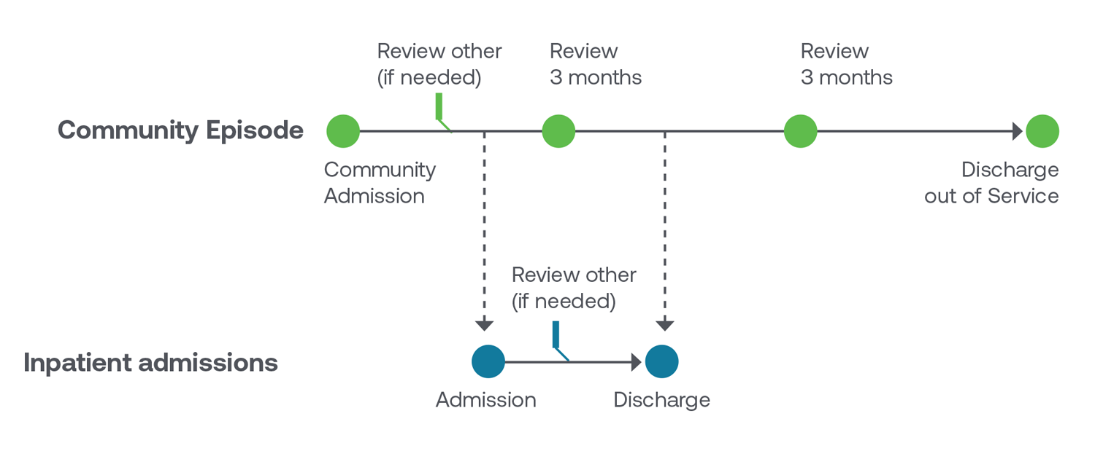
New transfer rules

Slide 28
Break out groups
Discuss: What is my understanding of the ICP for the HoNOS family of measures? Take 10 mins to discuss and raise any thoughts with main group as feedback

Slide 29
Rating focus of care
Assesses the primary goal of care
Based on concept of ‘phase of illness’ in people with psychiatric disorders
Rate main focus of care over whole episode - is therefore a retrospective measure
Single rating item to identify the main ‘focus of care’
Measures categories not rankings

Slide 30
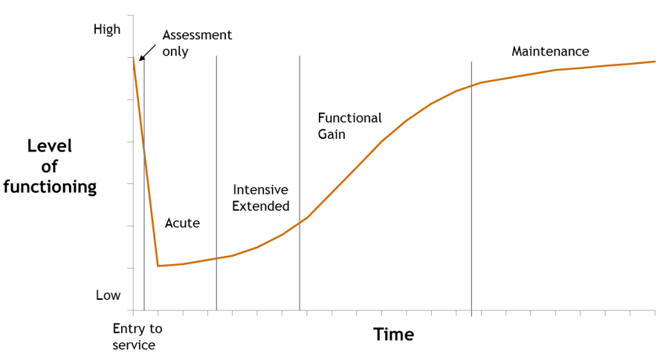
Focus of care
collected at assessment only, review and discharge reason for collection
not collected in CAMHS services

Slide 31
Focus of care
Focus of care | Primary goal
Acute | Short-term reduction in severity of symptoms and/or personal distress associated with recent onset or exacerbation of psychiatric disorder
Functional gain | Improve personal, social or occupational functioning or promote psychosocial adaptation in a person with impairment arising from a psychiatric disorder
Intensive extended | Prevent or minimise further deterioration and reduce risk of harm in a person who has a stable pattern of severe symptoms, frequent relapses, severe inability to function independently, and is judged to require care over an indefinite period
Maintenance | Maintain level of functioning, minimise deterioration or prevent relapse where the person has stabilised and functions relatively independently
Assessment only | The primary goal is only to assess the person

Slide 32
Break out group
Discuss what is my understanding of focus of care? 5 mins to discuss, no expectation of sharing with main group.

Slide 33
Summary module 1
Background
Collecting reliably
Information collection protocol
Focus of care

