Slide 1


HoNOS-secure Module 2
Train the trainer

Slide 2
Recap Module 1
HoNOS foundational messages
Research and reliability
Information collection protocol
Focus of care

Slide 3
Introducing HoNOS-secure
modified from12 original HoNOS items - addition of 7 ‘security scales’​
completed HoNOS secure score sheet provides a profile of 19 severity ratings
no overall total score but a total HoNOS score and a separate security score​.

Slide 4
HoNOS-secure
key measure of severity and impact
specifically broad spectrum
acceptable and useful to clinicians
satisfactory inter-rater reliability
change in scores correlate with independent clinical ratings of change
brief - about 5 minutes to rate
training required
shared with tāngata whai ora.

Slide 5
Requirements for rating HoNOS-secure
be a mental health clinician
be able to exercise clinical judgment
have been trained in the use of the HoNOS-secure
have completed a comprehensive assessment – information from all available sources.

Slide 6
Break out groups
Discuss: I understand the requirements for rating HoNOS secure?
10 mins

Slide 7
Reliability of ratings
achieving satisfactory inter-rater reliability is a key objective of the training
poor inter-rater reliability can be the result of misapplication of the rating rules
inter-rater reliability can be affected by the quality of assessment or lack of information between raters.
  (Australian Mental Health Outcomes and Classification Network (AMHOCN), 2004)

Slide 8
Security scales
There are 7 security scales:​
  A = risk of harm to adults or children​
  B = risk of self harm (deliberate or accidental)​
  C = need for building security to prevent escape​
  D = need for a safely staffed living environment​
  E = need for escort on leave (beyond secure perimeter)​
  F = risk to individual from others​
  G = need for risk management procedures.​

Slide 9
The HoNOS – 12 scales (adult version)
Overactivity, aggression​
Non-accidental self-injury​
Problem drinking or drug-taking​
Cognitive problems​
Physical illness or disability problems​
Problems associated with hallucinations or delusions​
Problems with depressed mood​
Other mental and behavioural problem​
Problems with relationships​
Problems with activities of daily living​
Problems with living conditions​
Problems with occupation and activities​

Slide 10
Rating the scales
Each scale is scored:​
  4 = severe problem​
  3 = moderate problem​
  2 = mild problem​
  1 = sub-clinical problem​
  0 = no problem​
  7 = not known (not enough information to make a judgment regarding presence or severity of a problem) ​

Slide 11
Rating rules
rate scales (items) in order from A to G and 1 to 12​
use all available information in making your rating​
do not include information rated in an earlier scale​
consider both the degree of distress the problem causes and the effect it has on behaviour​
rate the most severe problem that occurred in the rating period​
for the HoNOS component the rating period is generally 2 weeks, except at discharge from inpatient care, when it is the previous 3 days​
as far as possible the use of rating point 7 should be avoided​
specific information on how to rate each point on each scale is provided in the guide for NZ clinicians and the ICP.​

Slide 12
Rating the security scales
need an up to date clinical history and risk assessment​
review past incidents and behaviours, attitudes held, current progress etc.​
assess most serious potential problem in near future including where relevant if living unsupported in the community​
‘near future’ consider risk emerging in coming weeks or months that requires risk management/secure care at the current time​
if outcome unpredictable assess in proportion of degree of risk likely to occur​
then rate conclusions of the risk assessment and current need for secure care.

Slide 13
Break out groups
I understand how to rate the security scales?
10 mins

Slide 14
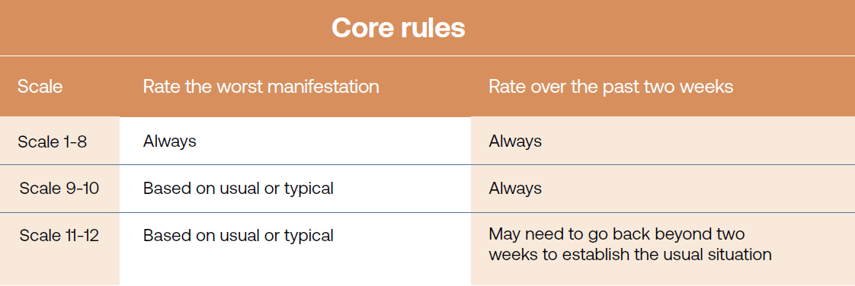
Rating guide

Slide 15
Training vignettes
Rating HoNOS-secure - Asad

Slide 16
Vignette
Read the Asad vignette and then rate both the security scales and the 12 items
20 mins

Slide 17
Discussion on Vignette
We will go through the consensus ratings for the Asad Vignette

Slide 18
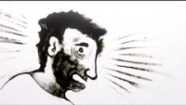

Slide 19
HoNOS-secure
Reporting

Slide 20
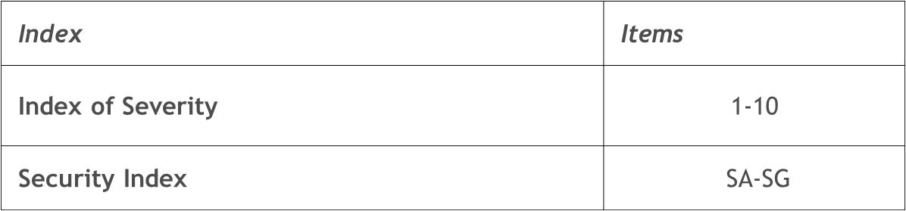
Proposed index for HoNOS-secure
Severity | Index of Severity Condition | Security Index Condition
Subclinical | All items rated <2 | All items rated <1
Mild | At least one item >1 and all items <3 | At least one item >=1 and all items <3
Moderate | At least one item >=3 | At least one item >=3
Severe | At least two items >=3 | At least two items >=3

Slide 21
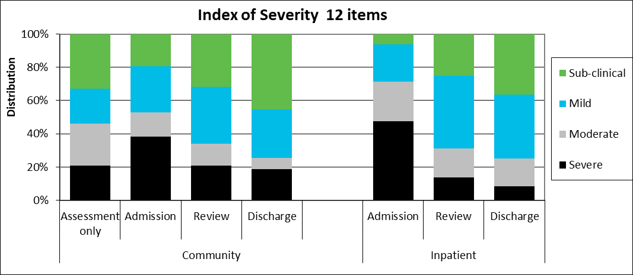
Index of Severity 12 items for HoNOS secure by collection type and setting, all DHBs, Jan to Dec 2020
Note: Index of Severity 12 items: Sub clinical = all items <2, mild = at least one item >1 and all items <3, moderate = at least one item >=3, severe = at least 2 items >=3 using first 10. Community discharge does not include discharge to an inpatient unit. Source: Ministry of Health, PRIMHD extract 28 March 2021, analysed and formatted by Te Pou.

Slide 22
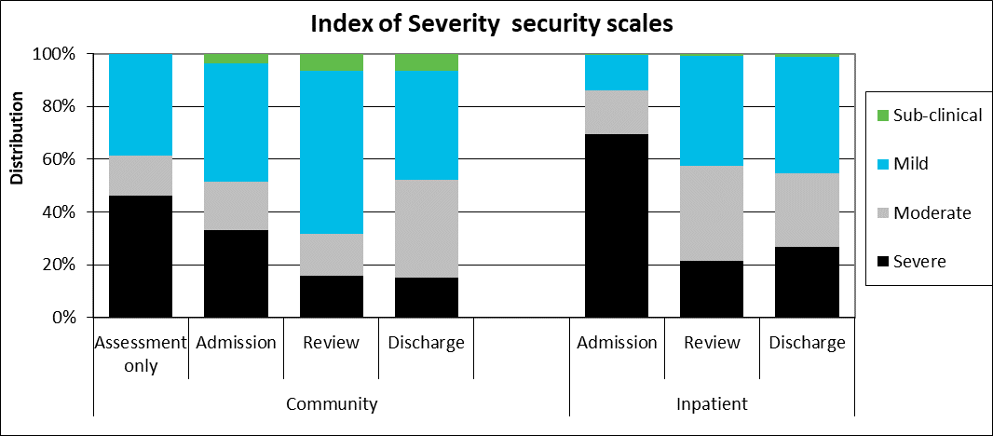
Index of Severity security scales for HoNOS secure by collection type and setting, all DHBs, Jan to Dec 2020
Note: Index of Severity security scales: sub-clinical = all items <1, mild = at least one item > =1 and all items <3, moderate = at least one item >=3, severe = at least 2 items >=3. Community discharge does not include discharge to an inpatient unit. Source: Ministry of Health, PRIMHD extract 28 March 2021, analysed and formatted by Te Pou.

Slide 23
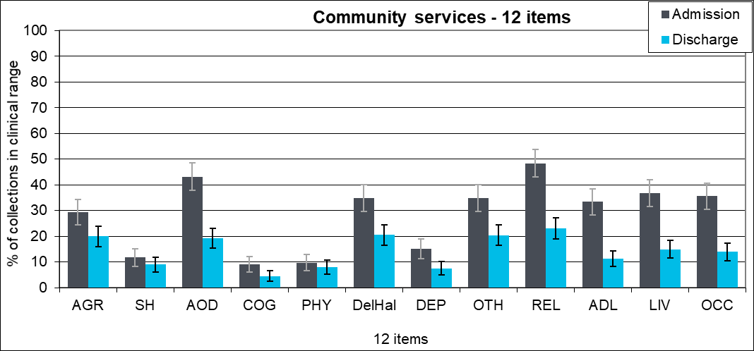
Percentage of collections in clinical range on each HoNOS secure 12 items by collection type, community: all DHBs, Jan to Dec 2020
Note: Percentage of service users in the clinical range (2, 3 or 4) for each HoNOS secure 12 items. Community discharge does not include discharge to an inpatient unit. Source: Ministry of Health, PRIMHD extract 28 March 2021, analysed and formatted by Te Pou.

Slide 24
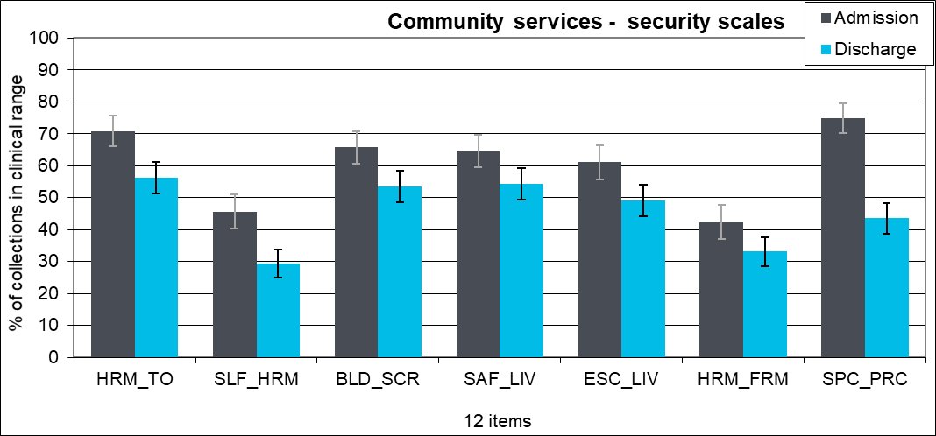
Percentage of collections in clinical range on each HoNOS secure security scales by collection type, community: all DHBs, Jan to Dec 2020
Note: Percentage of service users in the clinical range (1, 2, 3 or 4) for each HoNOS secure security scales. Community discharge does not include discharge to an inpatient unit. Source: Ministry of Health, PRIMHD extract 28 March 2021, analysed and formatted by Te Pou.

Slide 25
Summary module2
Clinical significance
Rating rules for HoNOS secure
practice

Slide 26

Full Image Slide

